Slide 1
Introduction to Information Technology
Authors: Turban, Rainer and Potter
Publisher: John Wiley & Sons, Inc.
Slides by: Hellene Bankowski, Professor, Philadelphia University
Copyright 2007 John Wiley & Sons, Inc.
Chapter 5

Slide 2
Chapter 5
Network Computing
Copyright 2007 John Wiley & Sons, Inc.
Chapter 5

Slide 3
Chapter Outline
5.1 Types of Networks
5.2 Internet
5.3 The World Wide Web
5.4 Network Applications
5.5 E-Learning and Distance Learning
5.6 Telecommuting
Copyright 2007 John Wiley & Sons, Inc.
Chapter 5

Slide 4
Learning Objectives
Describe the two major types of networks.
Differentiate among the Internet, the World Wide Web, intranets and extranets.
Describe the four major network applications.
Describe groupware capabilities.
Differentiate between e-learning and distance learning.
Understand the advantages and disadvantages of telecommuting for both employers and employees.
Copyright 2007 John Wiley & Sons, Inc.
Chapter 5

Slide 5
5.1 Types of Networks
Computer network
  is a system that connects computers via communications media so that data can be transmitted among them.
Local area network (LAN)
  connects two or more devices in a limited geographical region.
Copyright 2007 John Wiley & Sons, Inc.
Chapter 5

Slide 6
Local Area Network (LAN)
LAN consists of the following components:
  LAN file server is a repository of various software and data files for the network.
  Nodes are the client machines on the LAN.
  Wired or wireless communication media that connects the devices.
Copyright 2007 John Wiley & Sons, Inc.
Chapter 5

Slide 7
Local Area Network (Continued)
LAN network interface card (NIC)
  a special adapter that links an individual device to the communication medium and specifies:
    The rate of data tramsmission;
    The size of the message units;
    Addressing information attached to each message;
    The network topology.
Network operating system (NOS)
  manages the server and routes and manages communications on the network.
Copyright 2007 John Wiley & Sons, Inc.
Chapter 5

Slide 8
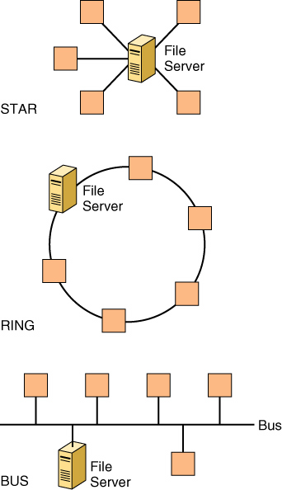
Network
Topology
Copyright 2007 John Wiley & Sons, Inc.
Chapter 5

Slide 9
Network Topologies
Star
  all network nodes connect to a single computer, typically the file server.
Bus
  all network nodes connect to the bus, which is a single communications channel, such as twisted pair, coaxial cable, or fiber optic cable.
Ring
  network nodes are connected to adjacent nodes to form a closed loop.
Copyright 2007 John Wiley & Sons, Inc.
Chapter 5

Slide 10
Wide Area Network (WAN)
Wide area networks (WANs) are networks that cover large geographic areas.
  WANs typically connect multiple LANs.
  WANs have large capacity and combine multiple channels (fiber optic, satellite, microwave, etc.).
  WANs provided by common carriers, such as telephone companies (Sprint, AT&T, etc.).
Copyright 2007 John Wiley & Sons, Inc.
Chapter 5

Slide 11
Enterprise Networking
Enterprise network is an organization’s interconnected network of multiple LANs and also can include multiple WANs.
Backbone networks are corporate high-speed central networks to which multiple smaller networks such as LANs called embedded LANs and smaller WANs connect.
Copyright 2007 John Wiley & Sons, Inc.
Chapter 5

Slide 12
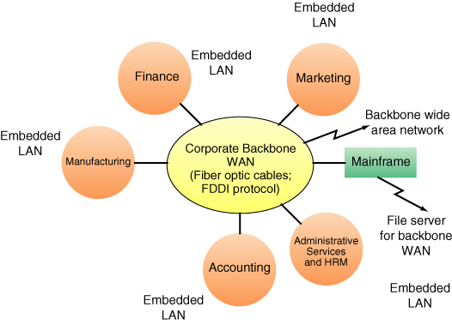
Enterprise Networking
Copyright 2007 John Wiley & Sons, Inc.
Chapter 5

Slide 13
5.2 The Internet
Internet (“the Net”)
  is a global WAN that connects approximately 1 million internal organizational computer networks in more than 200 countries on all continents.
ARPANET
  An experimental project started by the U.S. Department of Defense (DoD) in 1969
  To share data, exchange messages, transfer files.
Copyright 2007 John Wiley & Sons, Inc.
Chapter 5

Slide 14
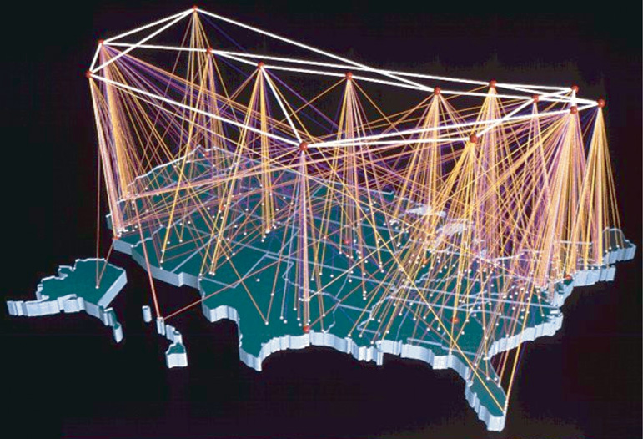
Internet (Backbone)
Copyright 2007 John Wiley & Sons, Inc.
Chapter 5

Slide 15
Internet Technologies
Intranet
  is a network designed to serve the internal informational needs of a single organization.
Extranet
  connects part of the intranets of different organizations and allows for secure communications among business partners over the Internet using virtual private networks.
Copyright 2007 John Wiley & Sons, Inc.
Chapter 5

Slide 16
Internet Technologies (Continued)
Virtual private network (VPNs) are private communications networks that use the internet for transmission.
Tunneling encrypts the data packet to be sent, and places it inside another packet; which provides confidentiality, authentication and integrity of the message.
Copyright 2007 John Wiley & Sons, Inc.
Chapter 5

Slide 17
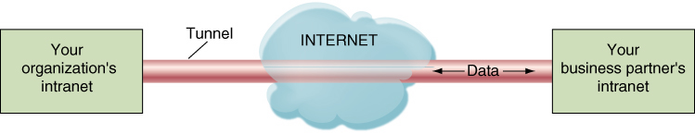
VPN and Tunneling
Copyright 2007 John Wiley & Sons, Inc.
Chapter 5

Slide 18
Darknets
Darknets are private networks that run on the Internet but are open only to users who belong to the network.
Three major uses:
  Freedom of speech where censorship exists;
  Corporate security to protect sensitive data;
  Copyright infringement - file-sharing software.
Copyright 2007 John Wiley & Sons, Inc.
Chapter 5

Slide 19
Operations of the Internet
Internet Protocol (IP) the set of rules used to send and receive packets from one machine to another over the Internet.
Packet switching is a transmission technology that breaks up blocks of text into small, fixed bundles of data called packets.
Copyright 2007 John Wiley & Sons, Inc.
Chapter 5

Slide 20
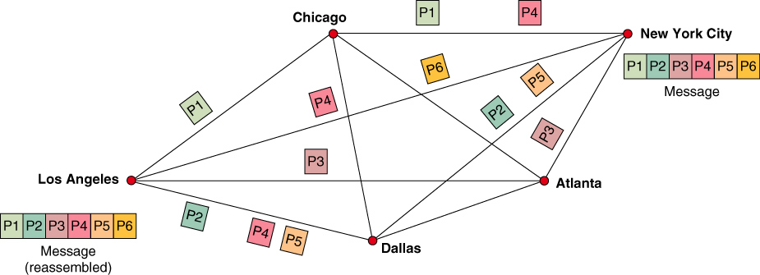
Package Switching
Copyright 2007 John Wiley & Sons, Inc.
Chapter 5

Slide 21
Assessing the Internet
Connecting via an Online Service by opening an account with an Internet Service Provider.
  Internet Service Provider (ISP)
    is a company that offers Internet connections for a fee. Examples are AOL, Comcast, Verizon.
Copyright 2007 John Wiley & Sons, Inc.
Chapter 5

Slide 22
Assessing the Internet (Continued)
Connecting via Other Means by making assess to the Internet cheaper, faster and easier.
  Internet Kiosks are terminals located in public places like libraries and airports for people who do not have computers.
  Internet access from cell phones, pagers and even connecting via satellite.
Copyright 2007 John Wiley & Sons, Inc.
Chapter 5

Slide 23
Addresses on the Internet
Each computer on the Internet has an assigned address, called an IP address. (i.e. 135.62.128.91)
Domain Name System (DNS) the naming system for IP addresses of companies.
Domain names consist of multiple parts, separated by dots, which are read from right to left. (i.e. www.internic.com)
Copyright 2007 John Wiley & Sons, Inc.
Chapter 5

Slide 24
5.3 The World Wide Web
World Wide Web (the Web, WWW, W3)
  is a system of universally accepted standards for storing, retrieving, formatting and displaying information via a client/server architecture and a graphical user interface.
Web site
  is all the pages of the organization.
Home page
  is a text and graphical screen display that welcomes the user and explains the organization that has established the page.
Copyright 2007 John Wiley & Sons, Inc.
Chapter 5

Slide 25
WWW (continued)
Webmaster the person in charge of the organization’s Web site.
Uniform resource locator (URL) points to an address of a specific resource on the Web.
Hypertext transport protocol (HTTP) is the communications standard used to transport pages across the Web portion of the Internet.
Copyright 2007 John Wiley & Sons, Inc.
Chapter 5

Slide 26
WWW (Continued)
Browsers
  provide a graphical front end that enable users to point-and-click their way across the Web, a process called surfing.
    Provide a uniform interface regardless of operating system.
    Leading browsers are Microsoft’s Internet Explorer, Mozilla’s Firefox, Netscape Navigator.
Copyright 2007 John Wiley & Sons, Inc.
Chapter 5

Slide 27
5.4 Network Applications
Network applications support businesses and other types of organizations in all types of functions including those in the following major categories:
  Discovery
  Communications
  Collaboration
  Web services
Copyright 2007 John Wiley & Sons, Inc.
Chapter 5

Slide 28
Discovery
Discovery allows users to browse and search data sources, in all topic areas, on the Web.
  Search engine is a computer program that searches for specific information by key words and reports the result.
  Directory is a hierarchically organized collection of links to Web pages.
Copyright 2007 John Wiley & Sons, Inc.
Chapter 5

Slide 29
Portals
Portal is a Web-based, personalized gateway to information and knowledge that provides relevant information from different IT systems and the Internet using advanced search and indexing techniques.
Commercial (public) portals offer content for diverse communities and are most popular portals on the Internet
Copyright 2007 John Wiley & Sons, Inc.
Chapter 5

Slide 30
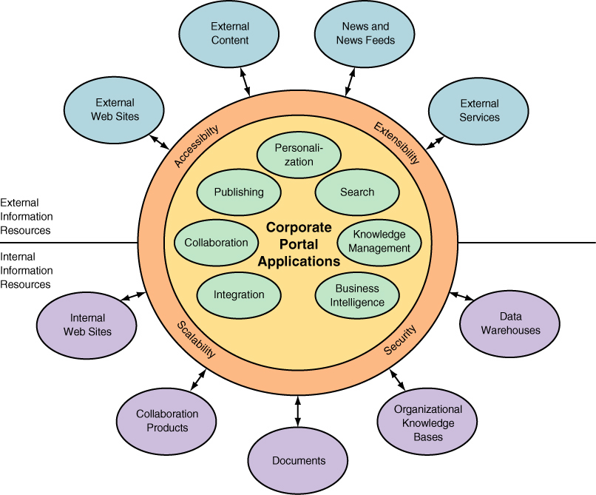
Corporate portal
Copyright 2007 John Wiley & Sons, Inc.
Chapter 5

Slide 31
Communication
Electronic mail (e-mail) is the largest-volume application running on the Internet.
Web-based call centers (customer call center) are services that provide effective personalize customer contact as an imporant part of Web-based customer support.
Electronic chat room is a virtual meeting place where groups of regulars come to “gab”.
Copyright 2007 John Wiley & Sons, Inc.
Chapter 5

Slide 32
Voice Communication
Internet telephony (VoIP) voice-over IP digitizes your analog voice signals, sections them into packets, and sends them over the Internet.
Weblog is a personal Web site, open to the public, where the creator expresses feelings or opinions.
Wiki is a Web site on which anyone can post material and make changes quickly, without using difficult commands.
Copyright 2007 John Wiley & Sons, Inc.
Chapter 5

Slide 33
Collaboration
Collaboration refers to efforts of two or more entities (individuals, teams, groups or organizations) who work together to accomplish certain tasks.
Work group refers specifically to two or more individuals who act together to perform some task.
Virtual group (team) is when group members are in different locations.
Copyright 2007 John Wiley & Sons, Inc.
Chapter 5

Slide 34
Groupware
Groupware refers to software products that support groups of people who share a common task or goal and who collaborate to accomplish it.
Teleconferencing is the use of electronic communication that allows two or mmore people at different locations to hold a simultaneous conference.
Copyright 2007 John Wiley & Sons, Inc.
Chapter 5

Slide 35
Groupware (Continued)
Videoconference is when participants in one location can see participants at other locations and share data, voice, pictures, graphics and animation by electronic means.
Web conferencing is videoconferencing conducted over the Internet.
Real-time collaboration tools support synchronous communication of graphical and text-based information i.e. computer-based whiteboards.
Copyright 2007 John Wiley & Sons, Inc.
Chapter 5

Slide 36
Web Services
Web services are applications, delivered over the Internet, that users can select and combine through almost any device (from personal computer to mobile phones).
  It is able to expose and describe itself to other applications, tell what services it does.
  It can be located by other applications via an online directory.
  It can be invoked by the originating application by using standard protocols.
Copyright 2007 John Wiley & Sons, Inc.
Chapter 5

Slide 37
E-Learning and Distance Learning
E-Learning
  refers to learning supported by the Web.
Virtual classrooms
  in which all coursework is done on-line and classes do not meet face-to-face.
Distance learning (DL)
  refers to any learning situation in which teachers and students do not meet face-to-face.
Copyright 2007 John Wiley & Sons, Inc.
Chapter 5

Slide 38
Benefits of E-Learning
Self-paced and self-initiated learning has been shown to increase content retention.
Online materials offer the opportunity to deliver very current content of high quality and consistent.
Students have the flexibility of learning from any place at any time at their own pace.
Learning time generally is shorter, and more people can be trained due to faster training time.
Training cost can be reduced, and savings can be made on facility space as well.
Copyright 2007 John Wiley & Sons, Inc.
Chapter 5

Slide 39
Drawbacks of E-Learning
Instructors may need training to be able to teach electronically.
The purchase of additional multimedia equipment may be necessary.
Students must be computer literate and may miss the face-to-face interaction with instructors.
There are issue with assessing students’ work, as instructors really do not know who completed assignments.
Copyright 2007 John Wiley & Sons, Inc.
Chapter 5

Slide 40
E-Learning (Continued)
Advanced e-learning support environments, such as Blackboard and WebCT, allow instructors to take advantage of new content and delivery technologies.
Virtual universities are online universities from which students take classes from home or at an off-site location, via the Internet.
Copyright 2007 John Wiley & Sons, Inc.
Chapter 5

Slide 41
Web 2.0
The term Web 2.0 is associated with web applications that facilitate participatory information sharing, interoperability, user-centered design,^{[1]} and collaboration on the World Wide Web.
Copyright 2007 John Wiley & Sons, Inc.
Chapter 5

Slide 42
Web 2.0 (cont’d)
A Web 2.0 site allows users to interact and collaborate with each other in a social media dialogue as creators (prosumers) of user-generated content in a virtual community, in contrast to websites where users (consumers) are limited to the passive viewing of content that was created for them.
Copyright 2007 John Wiley & Sons, Inc.
Chapter 5

Slide 43
Example Web 2.0
Examples of Web 2.0 include social networking sites, blogs, wikis, video sharing sites, hosted services, web applications, mashups and folksonomies.
Copyright 2007 John Wiley & Sons, Inc.
Chapter 5

Slide 44
Copyright 2007
John Wiley & Sons, Inc.
All rights reserved. Reproduction or translation of this work beyond that permitted in section 117 of the 1976 United States Copyright Act without express permission of the copyright owner is unlawful. Request for further information should be addressed to the Permissions Department, John Wiley & Sons, Inc. The purchaser may make back-up copies for his/her own use only and not for distribution or resale. The Publisher assumes no responsibility for error, omissions, or damages caused by the use of these programs or from the use of the information herein.
Copyright 2007 John Wiley & Sons, Inc.
Chapter 5

